Slide 1
Fanny Freesy’s Family

Slide 2
busy

Slide 3
growing up

Slide 4
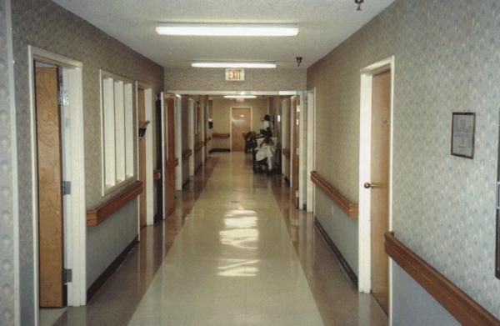
hall

Slide 5
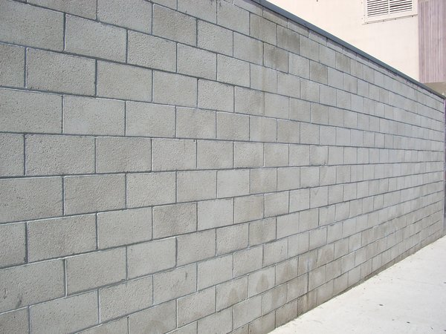
wall

Slide 6
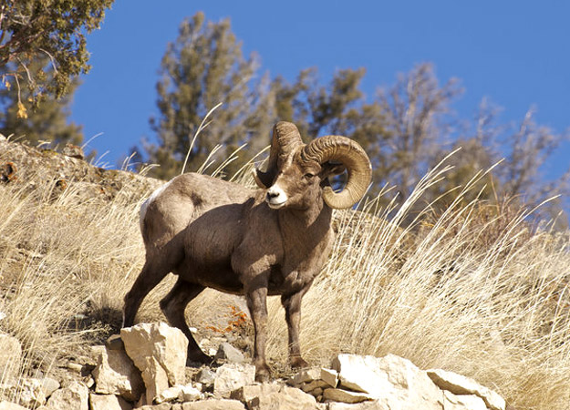
ram

Slide 7
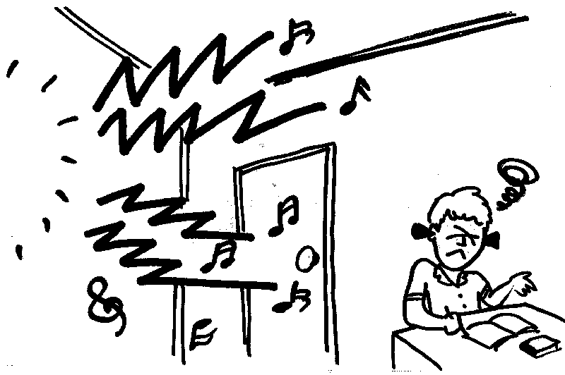
noisy

Slide 8
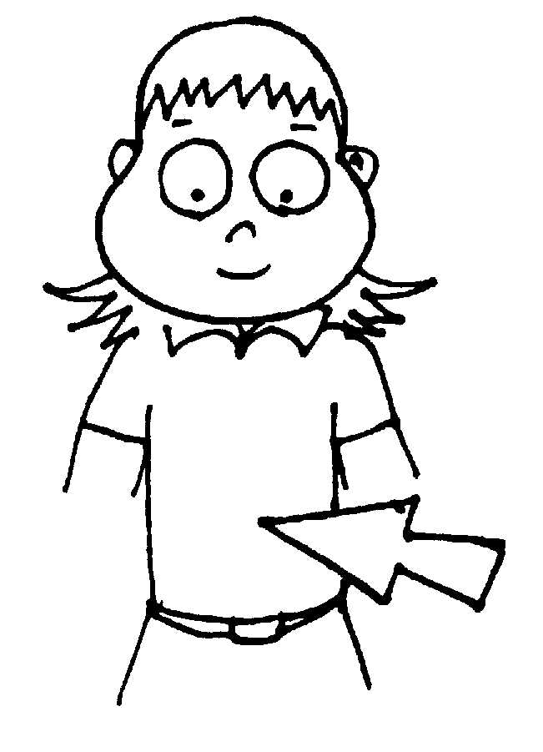
belly

Slide 9
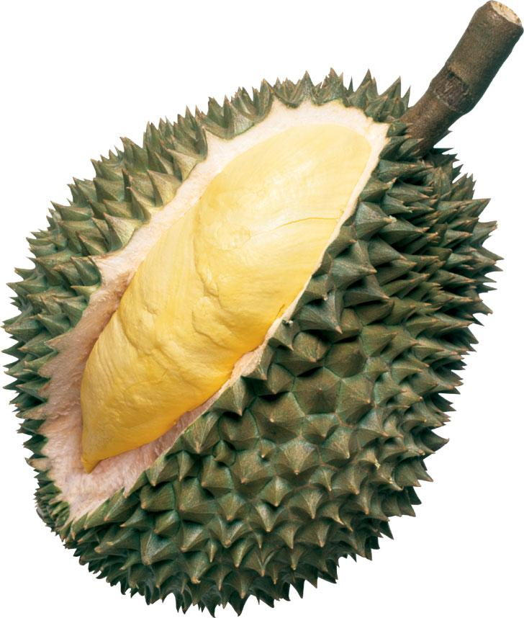
durian

Slide 10
lucky

Slide 11
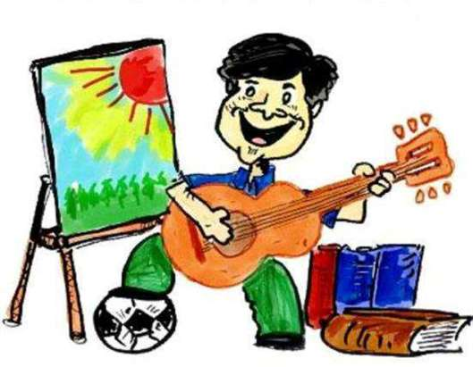
hobby

Slide 12
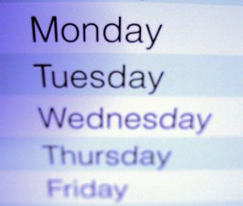
weekday

Slide 13
weekend

Slide 14
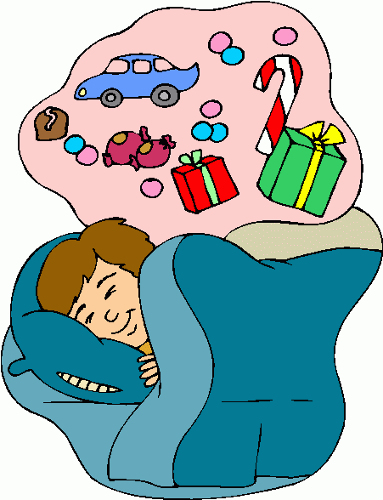
dreaming

Slide 15
role model

Slide 16
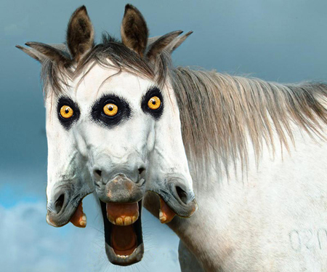
strange

Slide 17
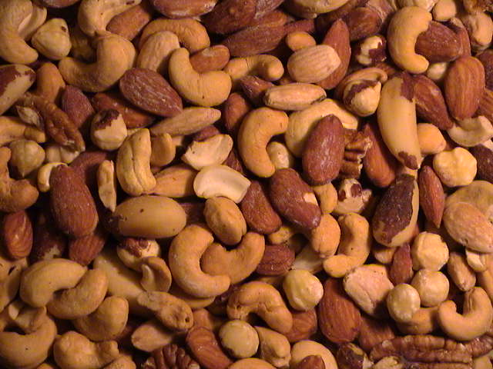
nuts

