Slide 1
Bugs, Beetles, and Butterflies

Slide 2
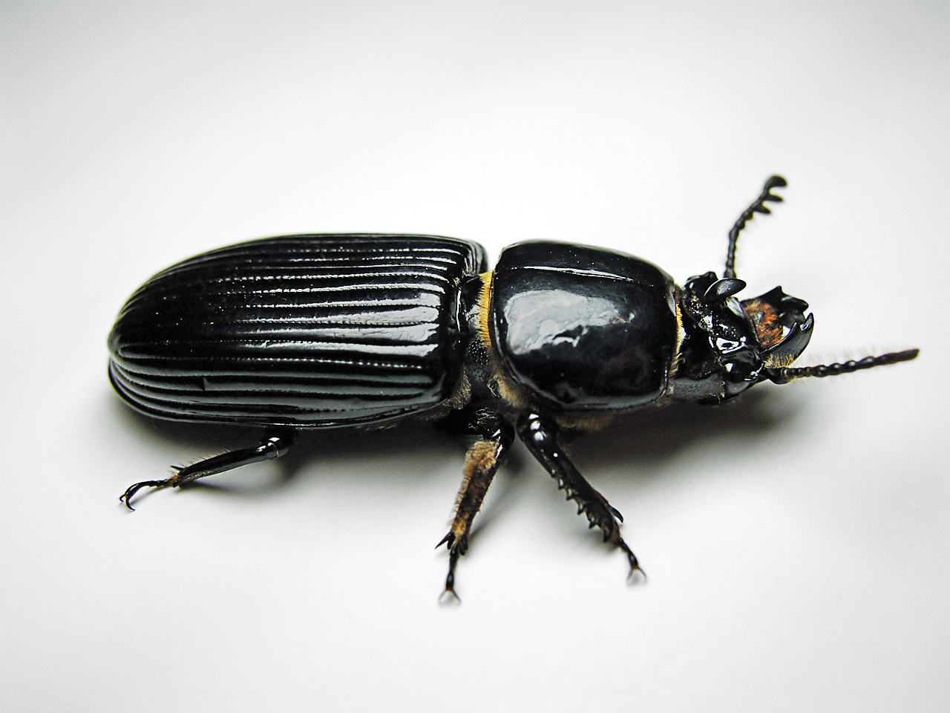
beetle

Slide 3
butterfly

Slide 4
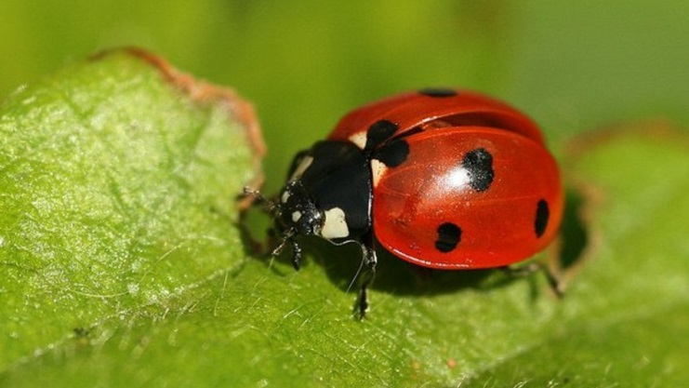
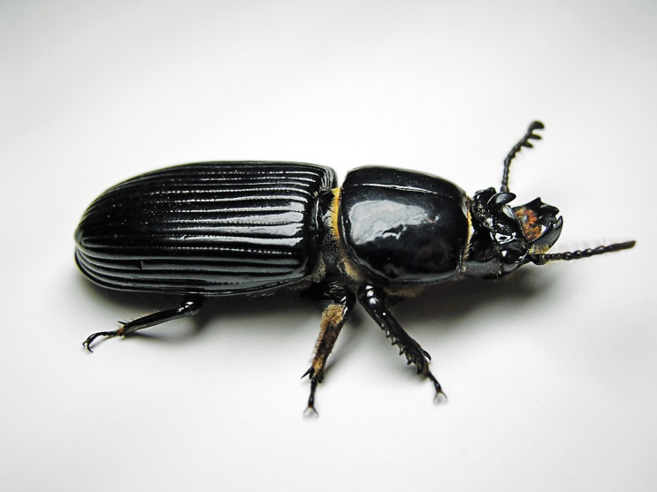
bug

Slide 5
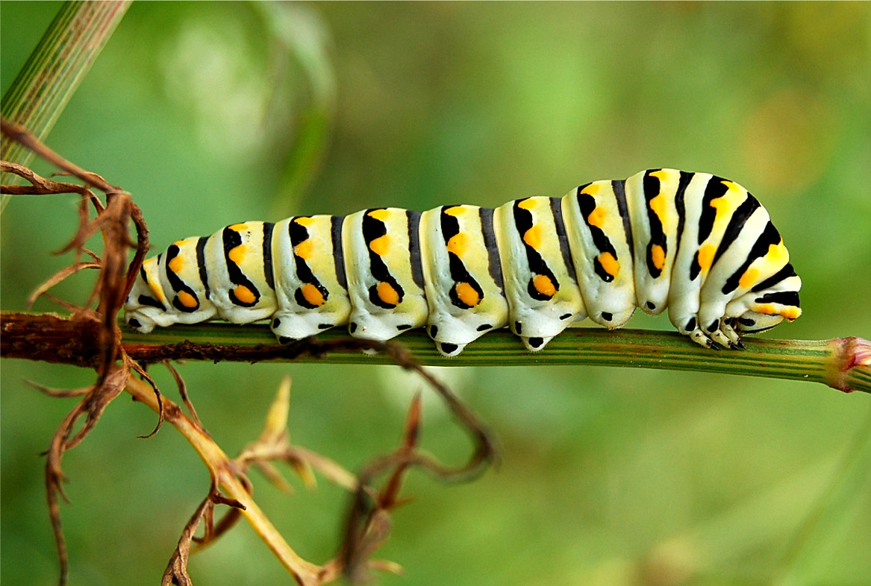
caterpillar

Slide 6
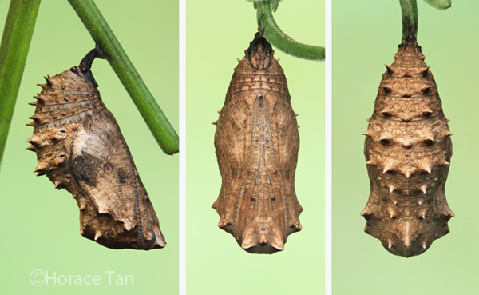
pupa

Slide 7
wing

Slide 8
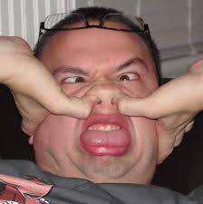
ugly

Slide 9
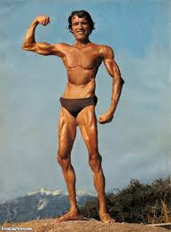
skinny

Slide 10
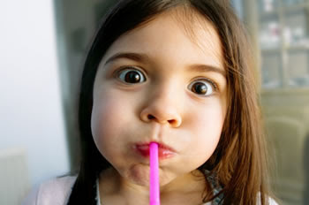
suck

Slide 11
thieves

Slide 12
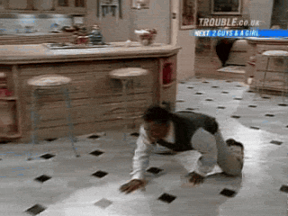
crawl

Slide 13
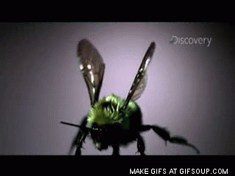
flutter

Slide 14
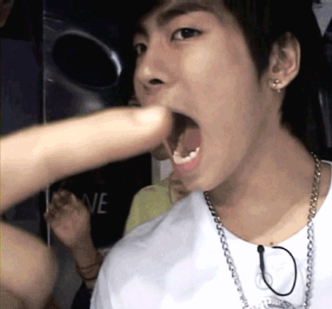
bite

Slide 15
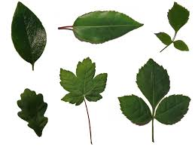
leaves

Slide 16
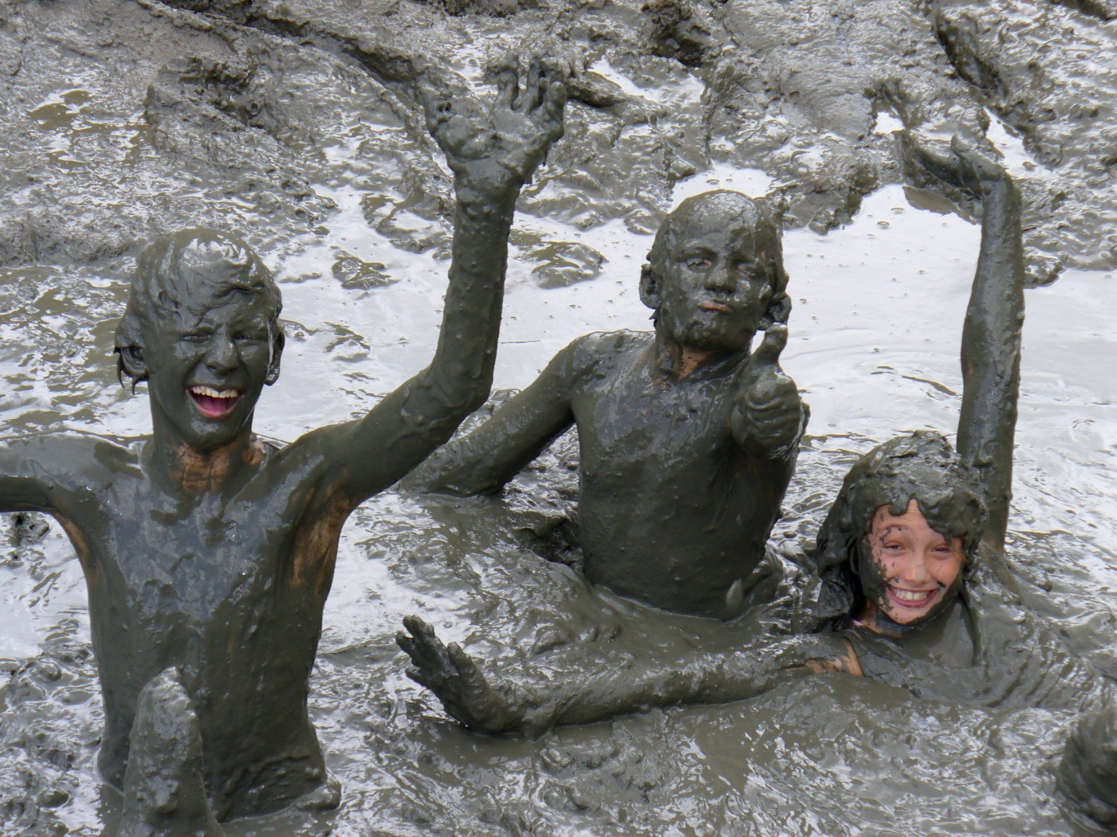
mud

Slide 17
crud

Slide 18
Tic Tac Toe – Boys Vs. Girls
X | O
 | X | O
O | X | X

Slide 51
Make a sentence!

Slide 52
Make a sentence!

Slide 53
Make a sentence!

Slide 54
Make a sentence!

Slide 55
Make a story!

