Slide 1
Sean

Slide 2
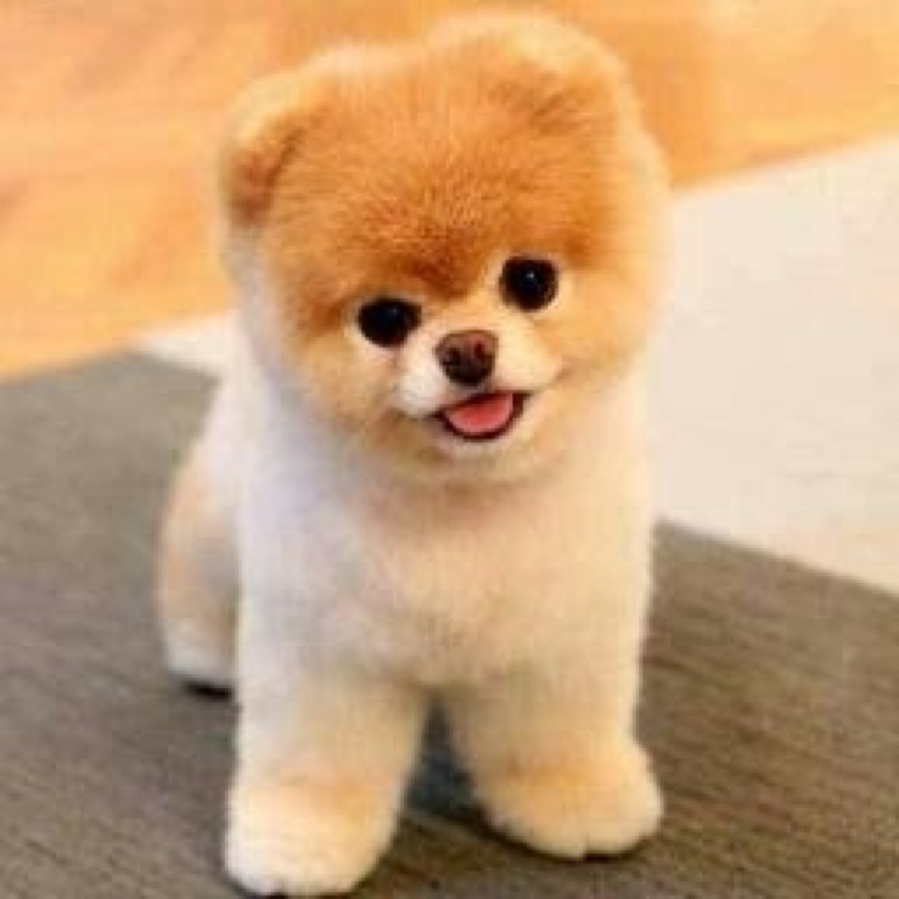
adorable

Slide 3
smile

Slide 4
incessantly

Slide 5
care

Slide 6
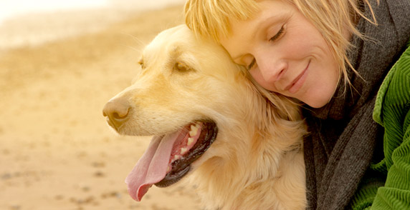
beloved

Slide 7
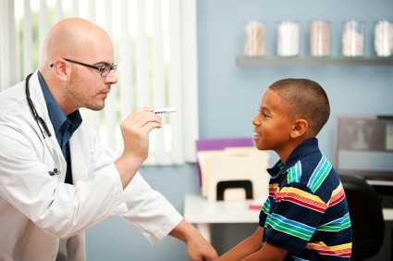
diagnose

Slide 8
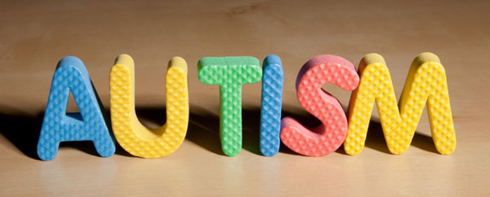
autism

Slide 9
learn

Slide 10
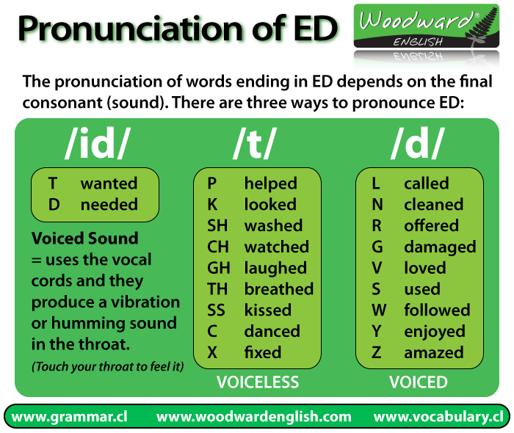
pronunciation

Slide 11
stroke

Slide 12
competition

Slide 13
second place

Slide 14
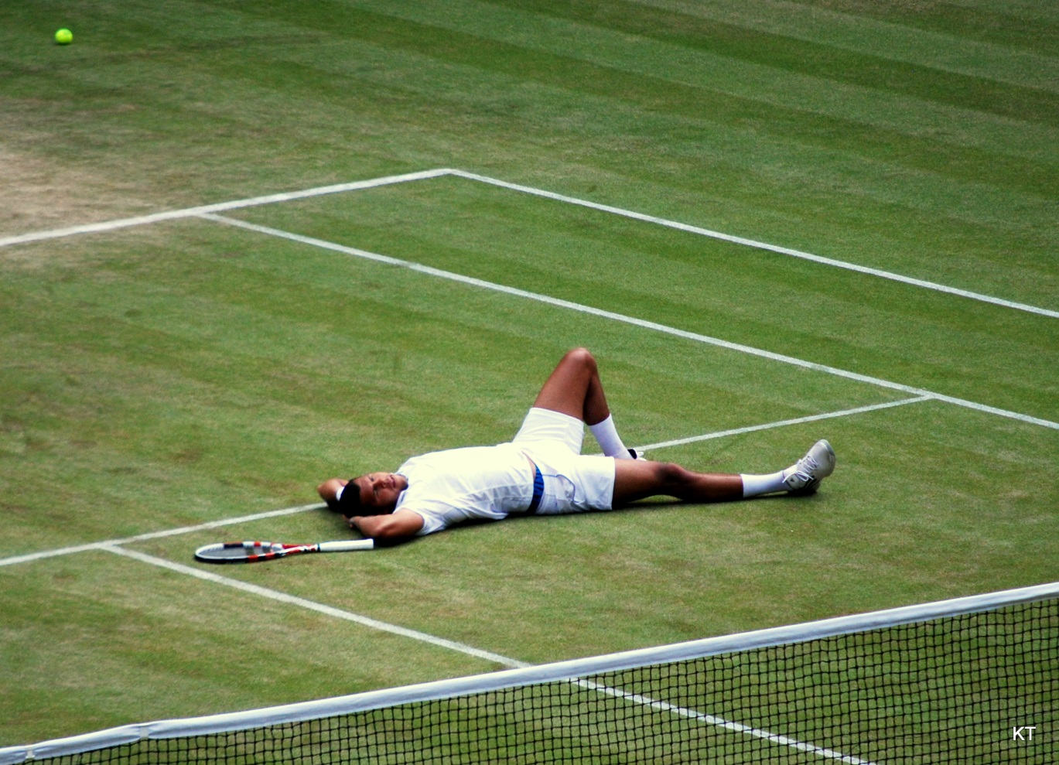
give up

Slide 15
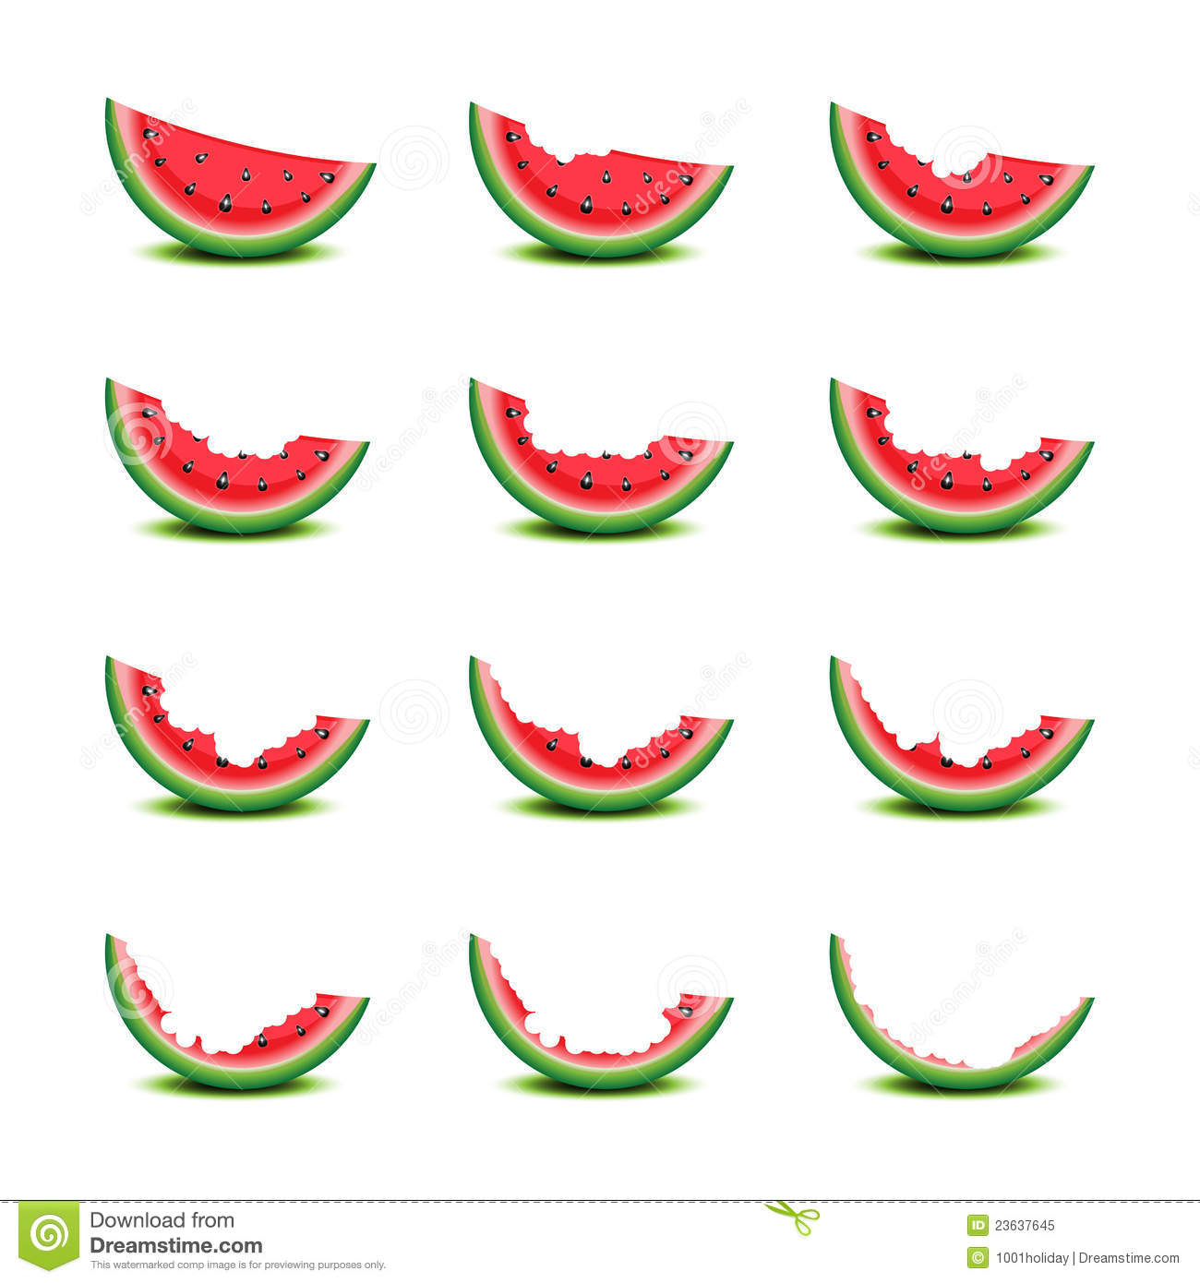
gradually

