Slide 1
Culture Around
the World

Slide 2
Continents

Slide 3
Can you remember the names?

Slide 4
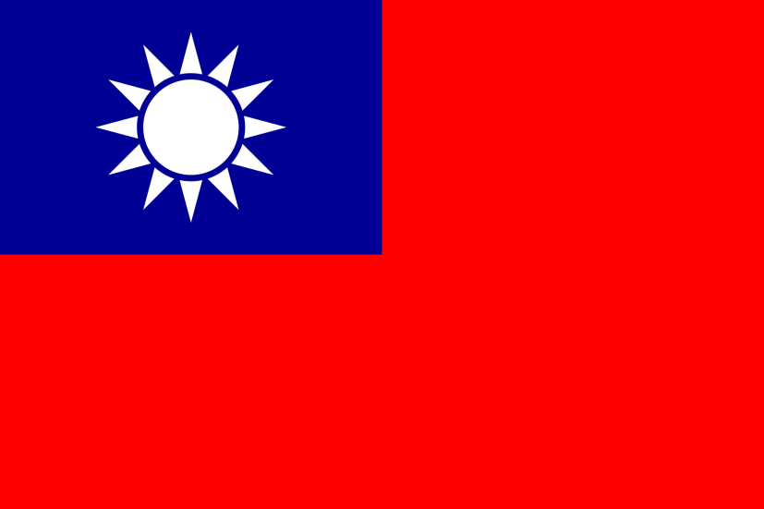
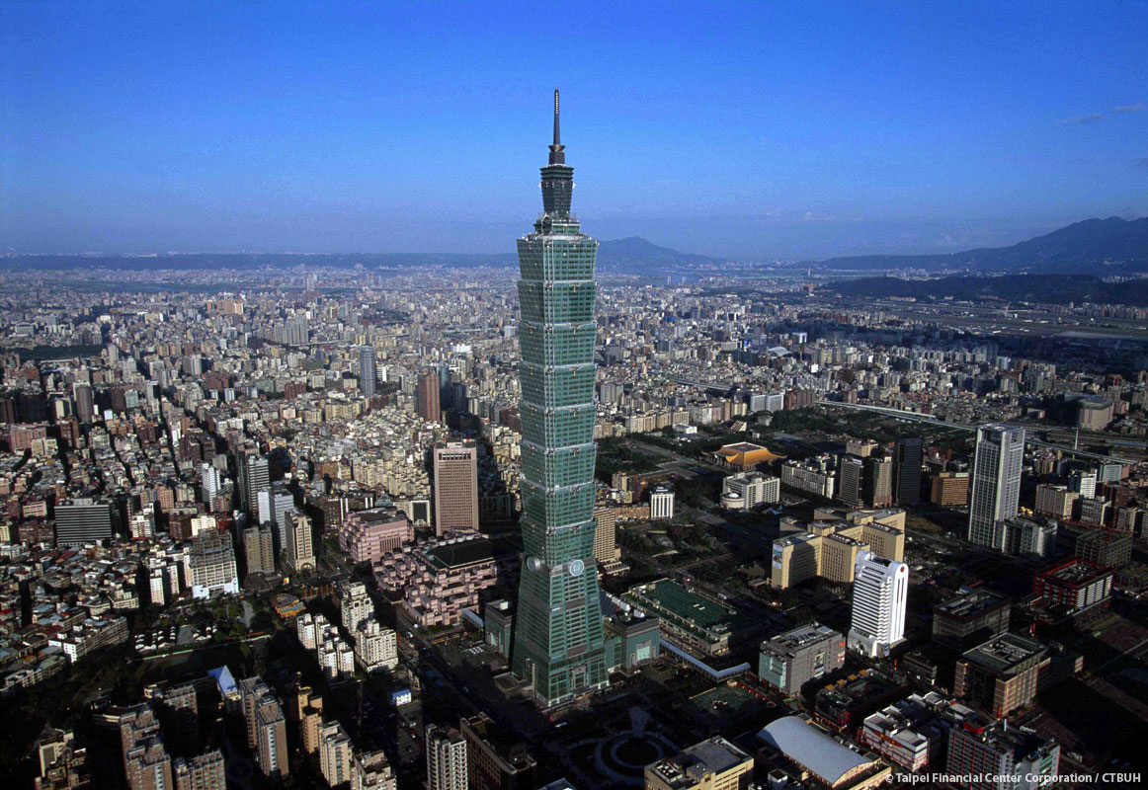
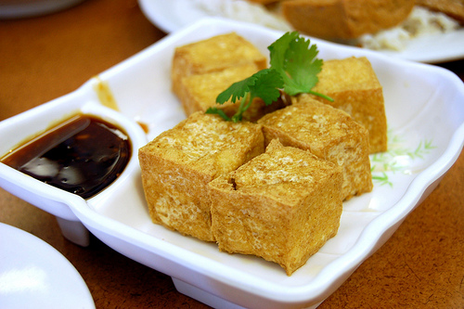
Let’s guess the country names.
Taiwan
Can you find Taiwan on the map?

Slide 5
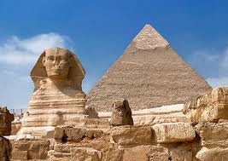
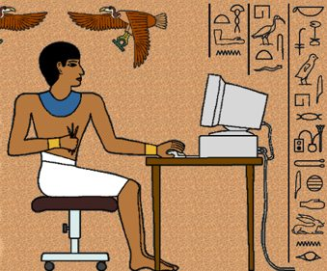
Egypt
Can you find Egypt on the map?

Slide 6
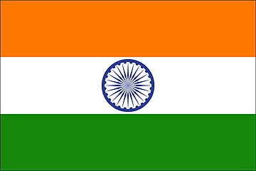
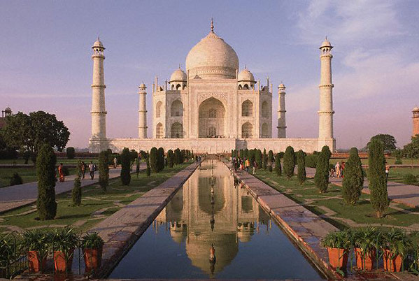
India
Can you find India on the map?

Slide 7
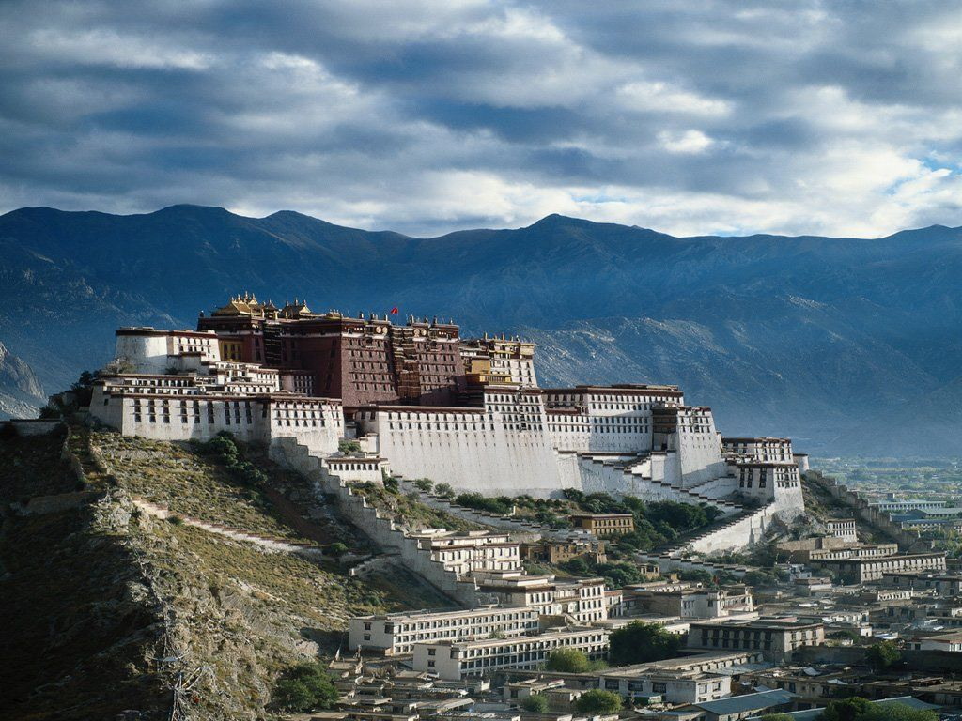
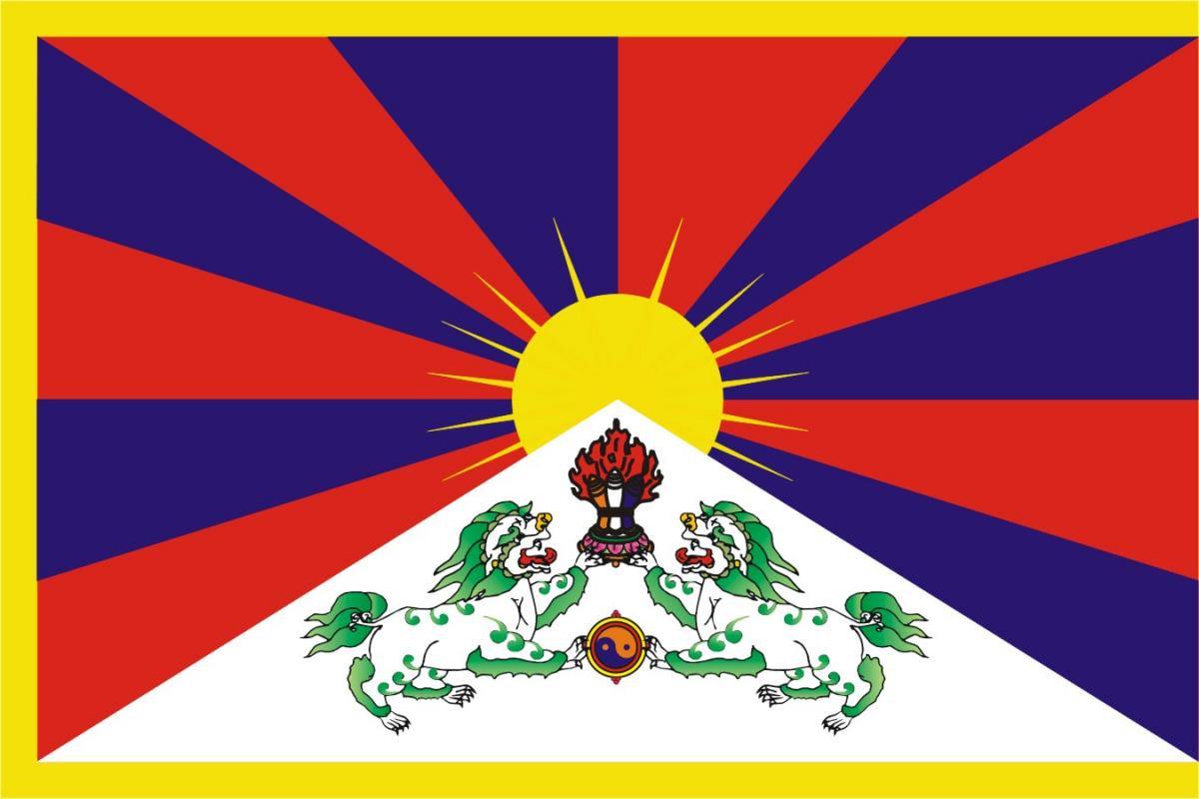
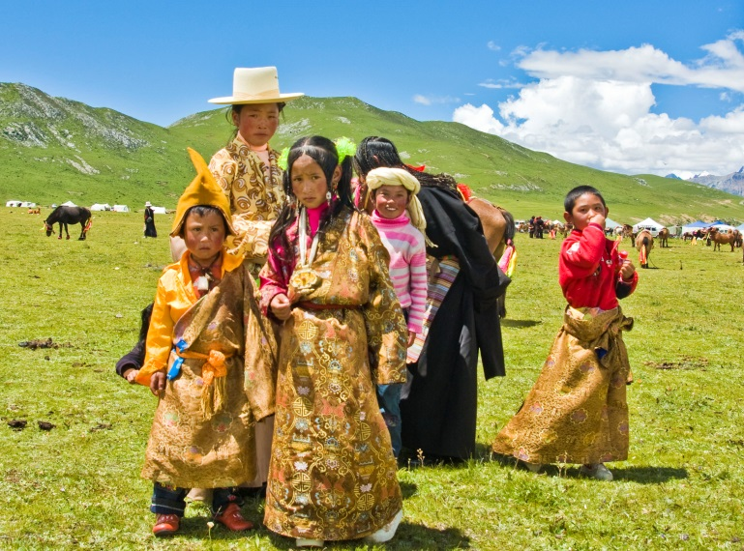
Tibet
Can you find Tibet on the map?

Slide 8
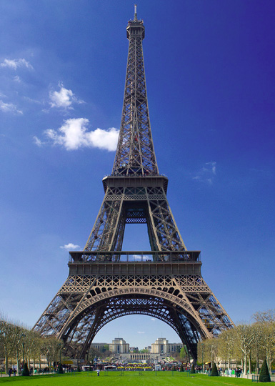
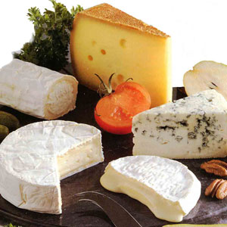
France
Can you find France on the map?

Slide 9
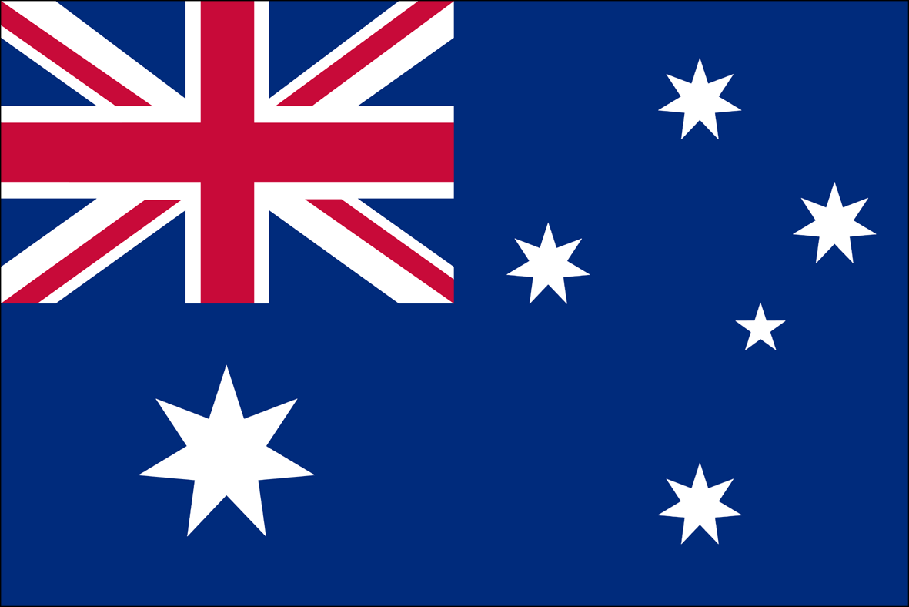
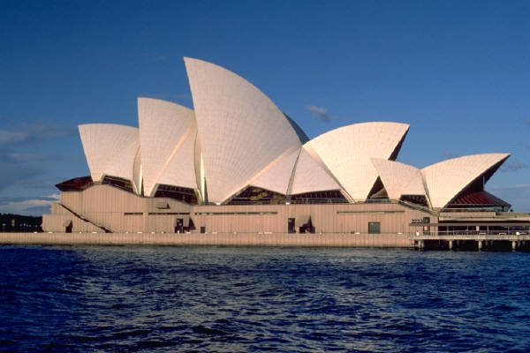
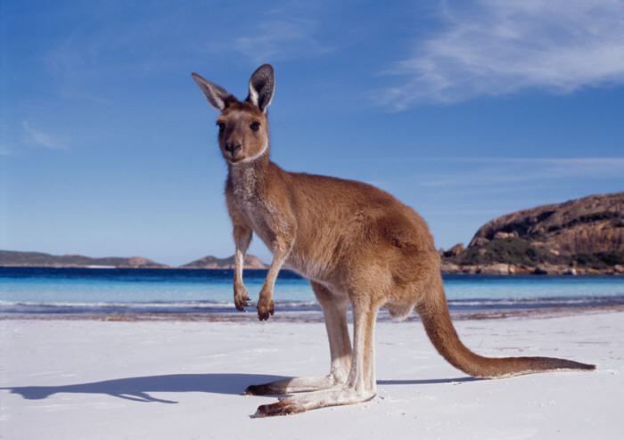
Australia
Can you find Australia on the map?

Slide 10
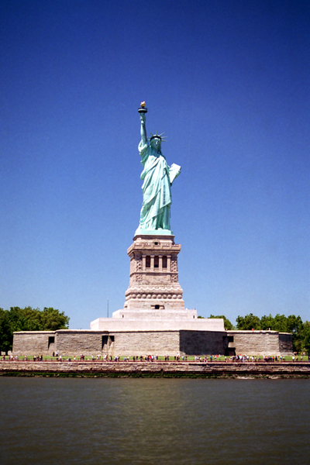
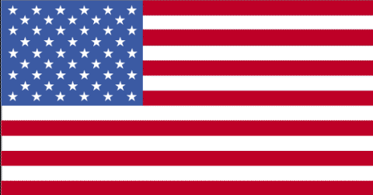
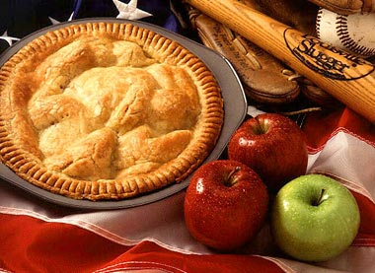
America
Can you find the America on the map?

Slide 11
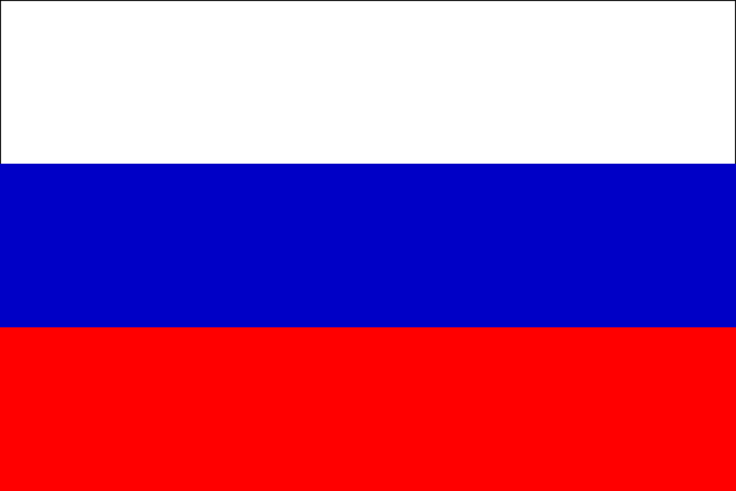
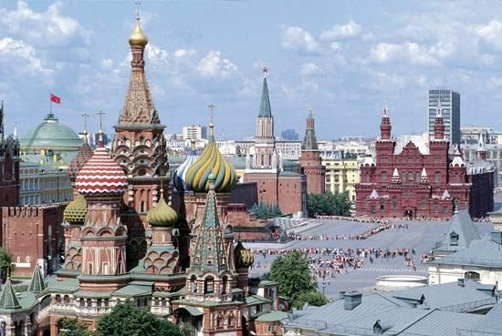
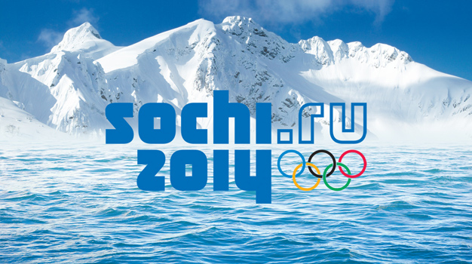
Russia
Can you find the Russia on the map?

Slide 12
Where’s the ________ ?
Taj Mahal
It’s in _________.
India

Slide 13
Where’s the ________ ?
Eiffel Tower
It’s in _________.
France

Slide 14
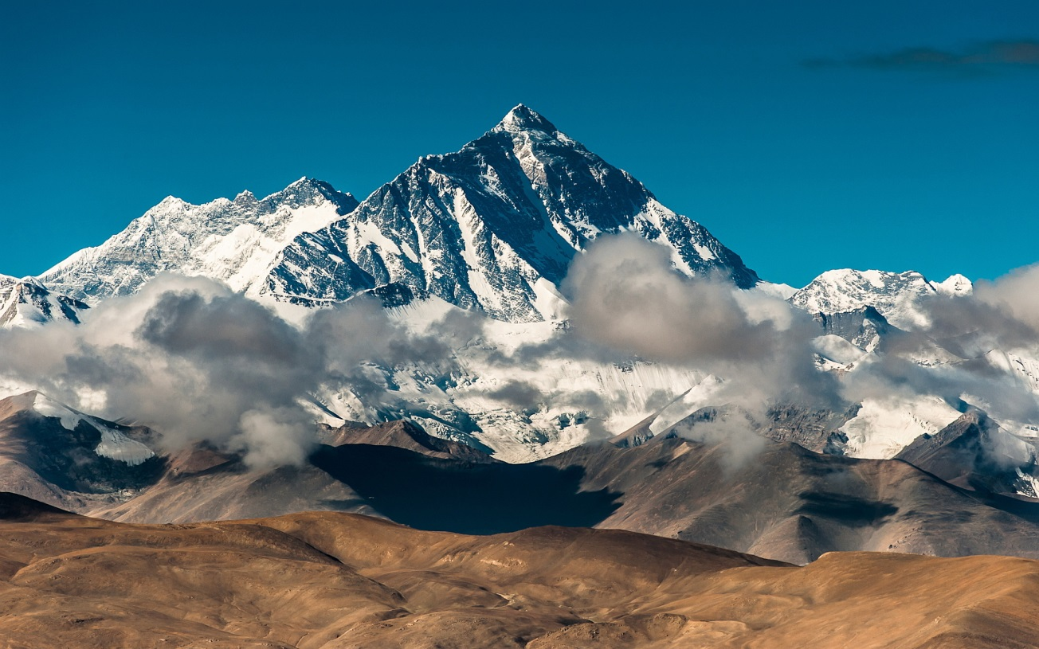
Where’s ________________ ?
Mount Everest
Tibet
It’s in _________.

Slide 15
Where’s the _____________ ?
Statue of Liberty
It’s in _________.
the United States

Slide 16
Where’s the _____________ ?
Red Square
It’s in _________.
Russia

Slide 17
Where’s the _____________ ?
Sydney Opera House
It’s in _________.
Australia

Slide 18
Where’s the _____________ ?
Pyramid
It’s in _________.
Egypt

