Slide 1
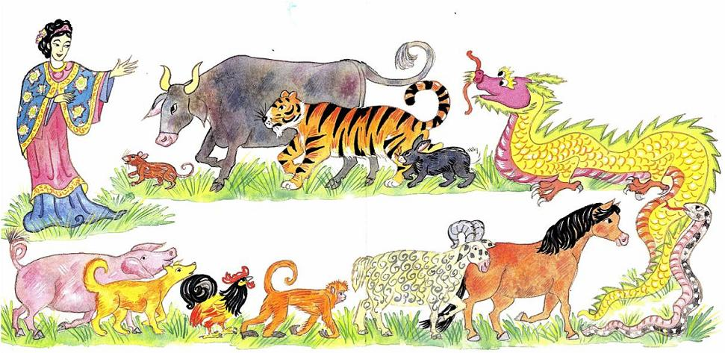
The Chinese New Year Joanna Troughton

Slide 2
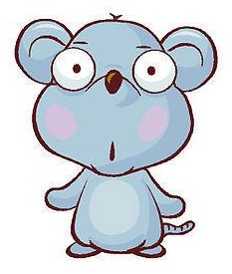
rat

Slide 3
ox

Slide 4
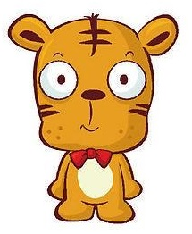
tiger

Slide 5
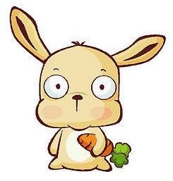
rabbit

Slide 6
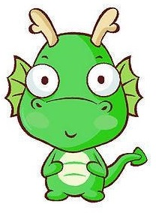
dragon

Slide 7
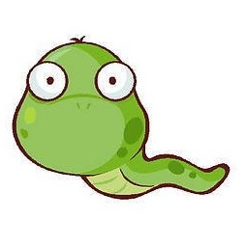
snake

Slide 8
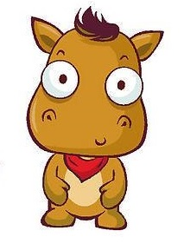
horse

Slide 9
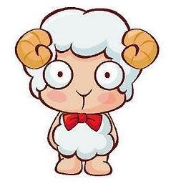
ram

Slide 10
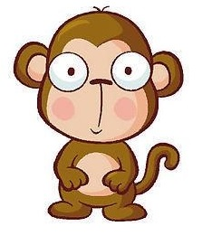
monkey

Slide 11
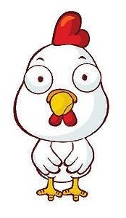
rooster

Slide 12
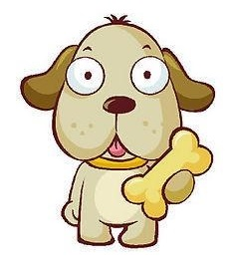
dog

Slide 13
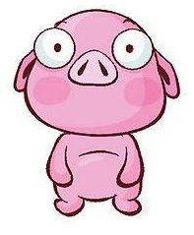
pig

Slide 14
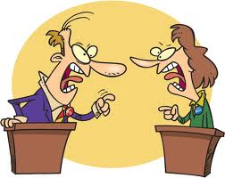
argue

Slide 15
clever

Slide 16
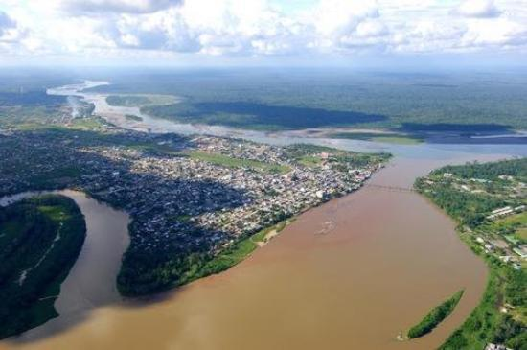
wide

Slide 17
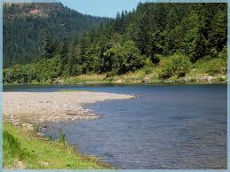
(river) bank

Slide 18
Practice

Slide 35
Tic Tac Toe – Boys Vs. Girls
X | O
 | X | O
O | X | X

Slide 36
Make a sentence!

Slide 37
Make a sentence!

Slide 38
Make a sentence!

Slide 39
Make a sentence!

