Slide 1
Wait and See

Slide 2
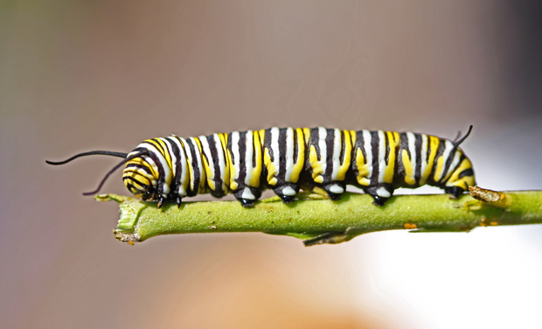
caterpillar

Slide 3
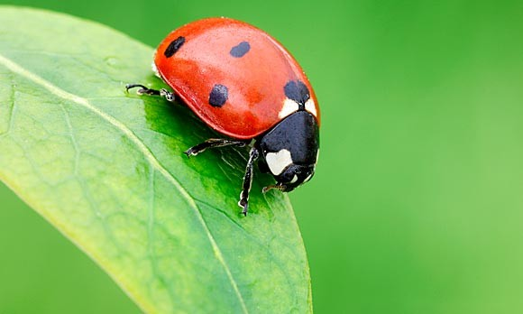
ladybug

Slide 4
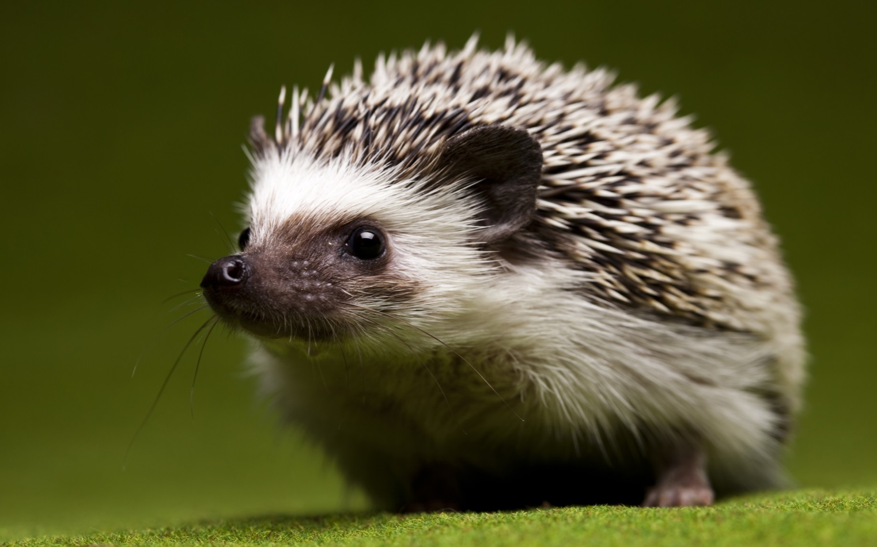
hedgehog

Slide 5
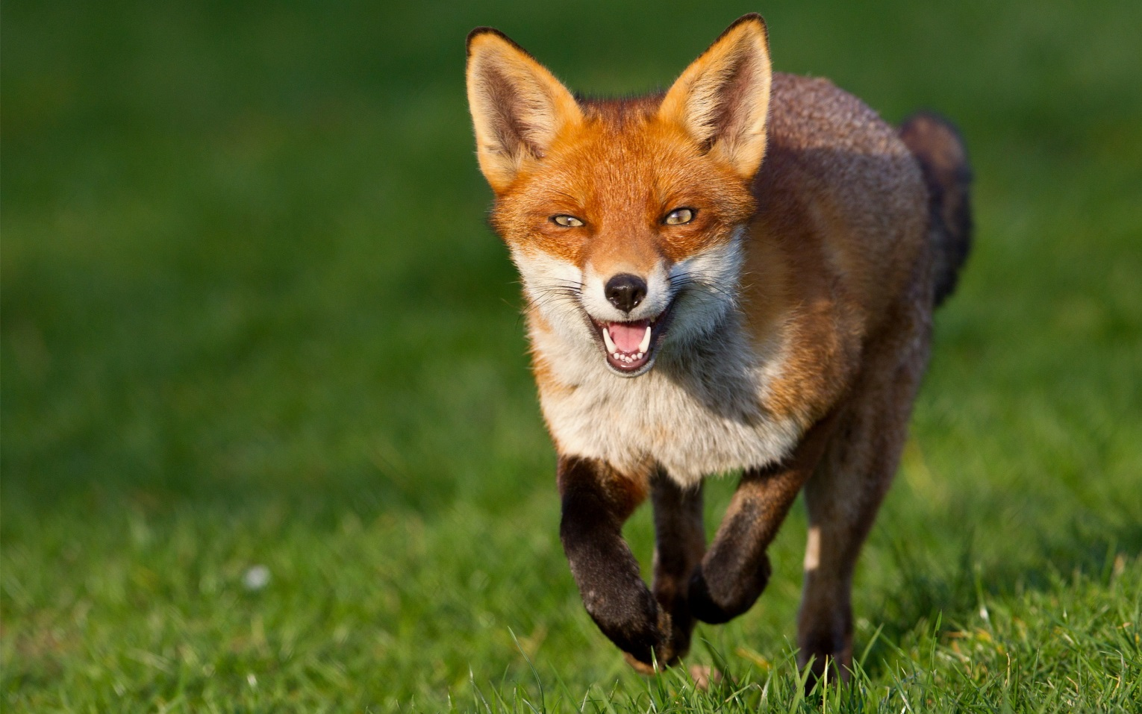
fox

Slide 6
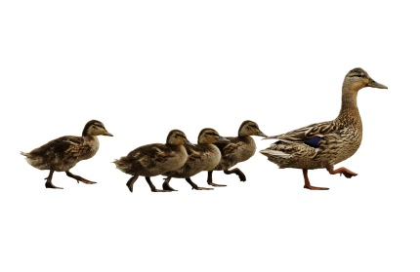
follow

Slide 7
silently

Slide 8
strong

Slide 9
trap

Slide 10
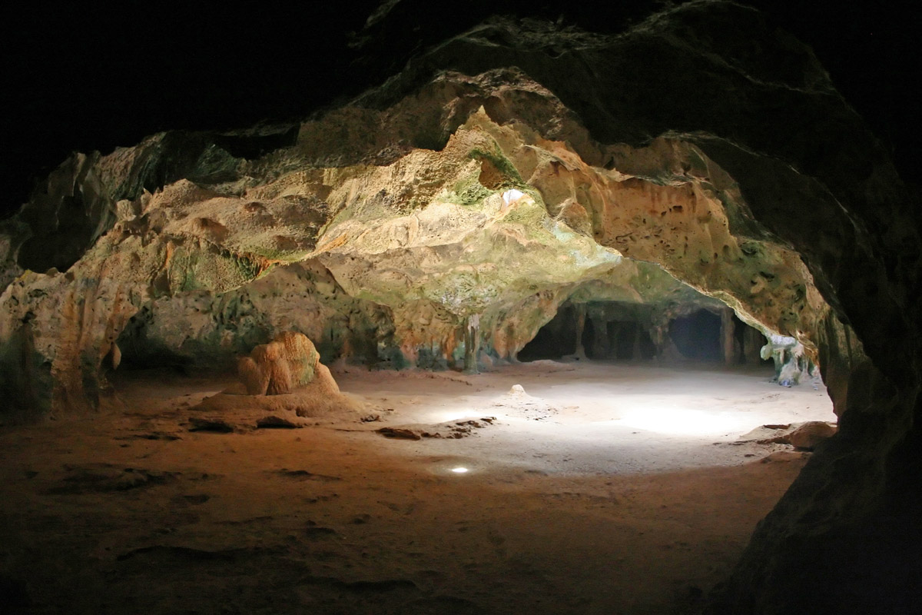
cave

Slide 11
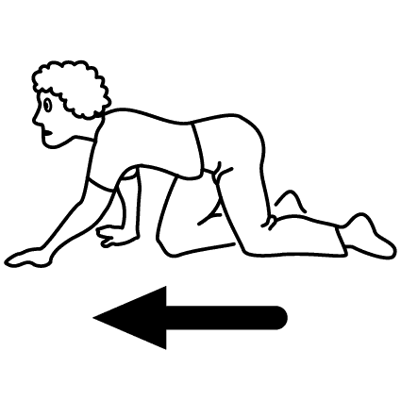
crawl

Slide 12
escape

Slide 13
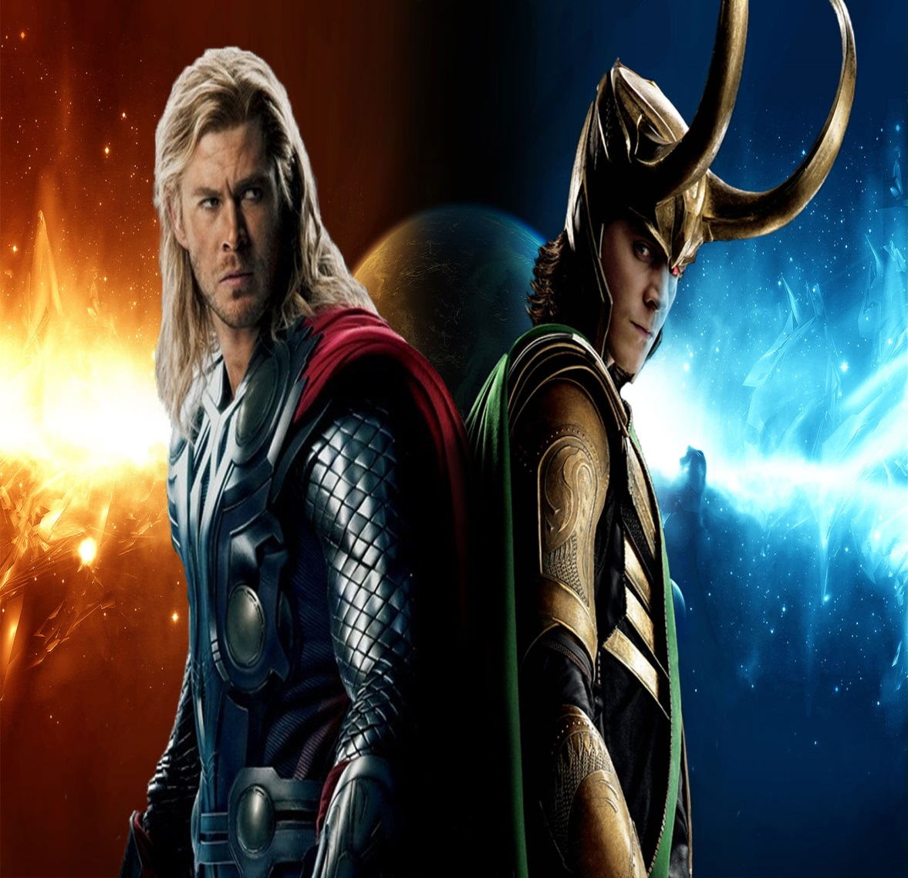
enemy

Slide 14
nervous

Slide 15
carefree

