Slide 1
The Amazing Mr. Mulch

Slide 2
term

Slide 3
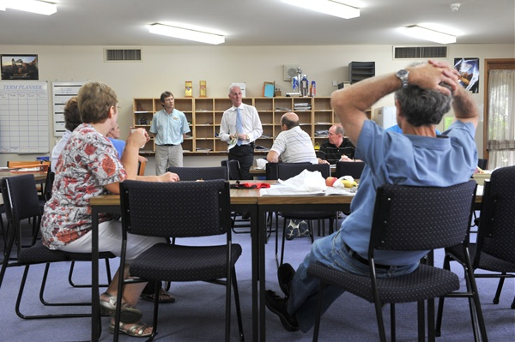
staff room

Slide 4
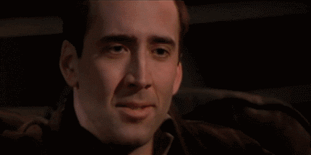
laugh

Slide 5
break

Slide 6
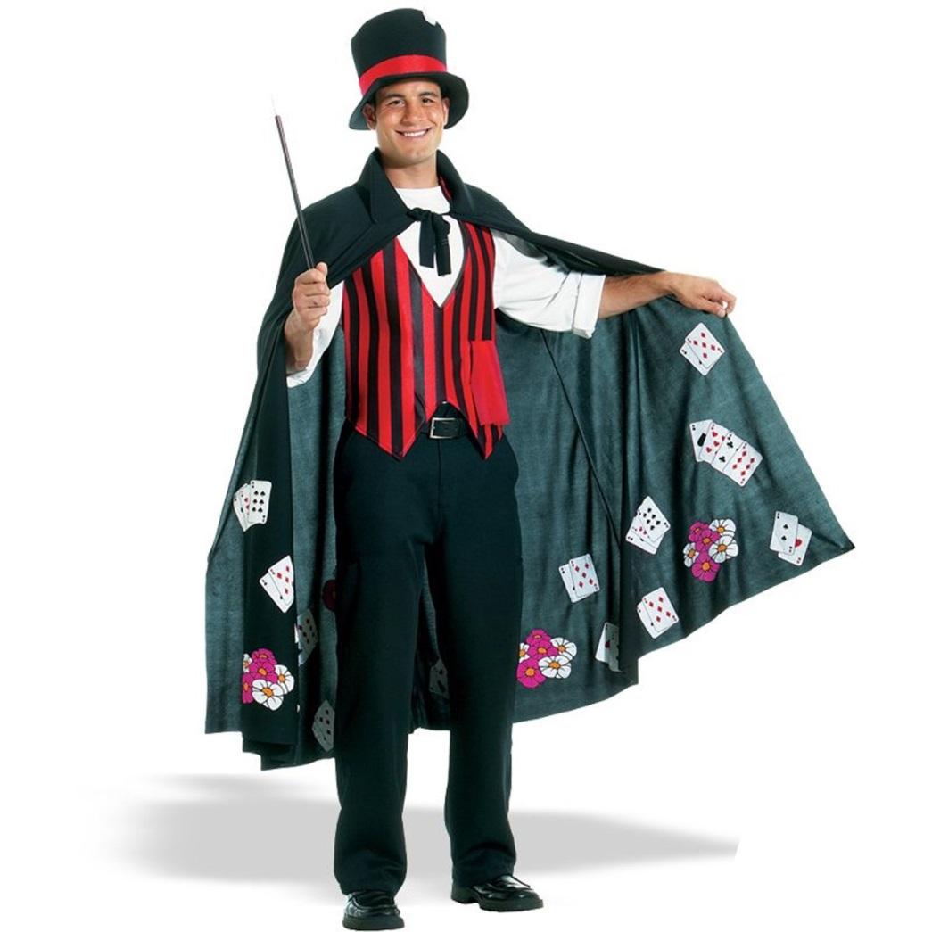
magician

Slide 7
crazy

Slide 8
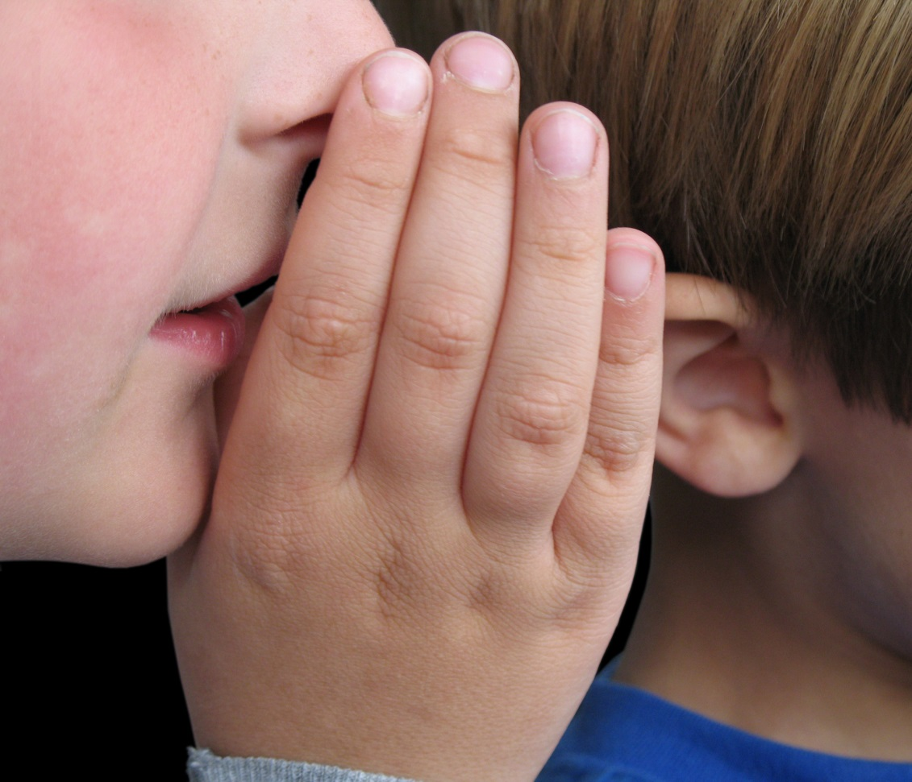
whisper

Slide 9
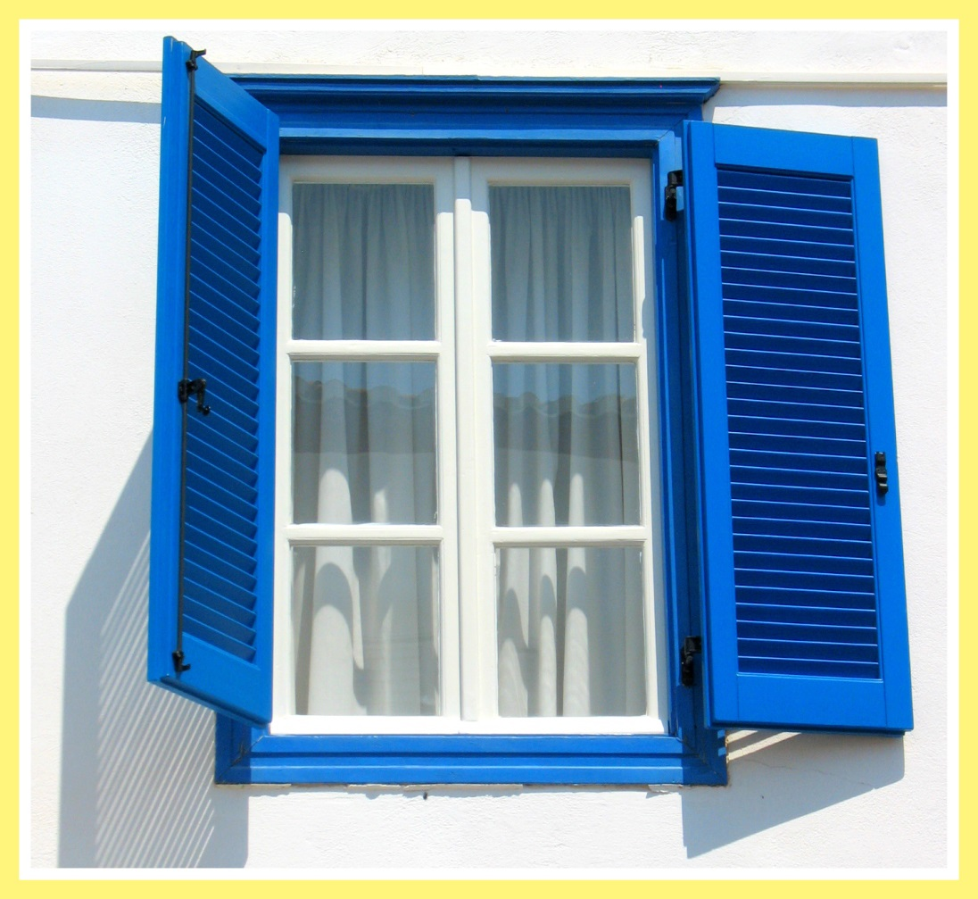
window

Slide 10
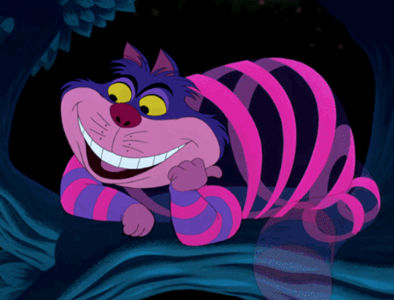
disappear

Slide 11
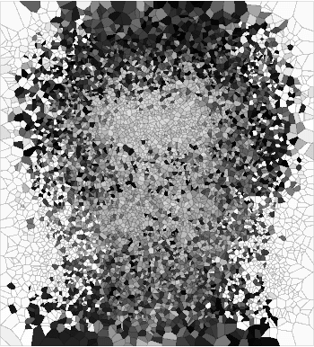
appear

Slide 12
invisible

Slide 13
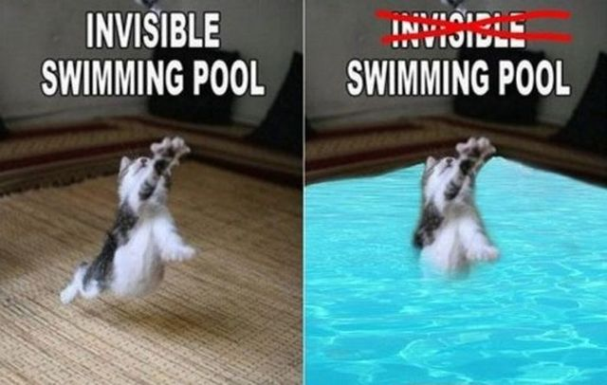
visible

Slide 14
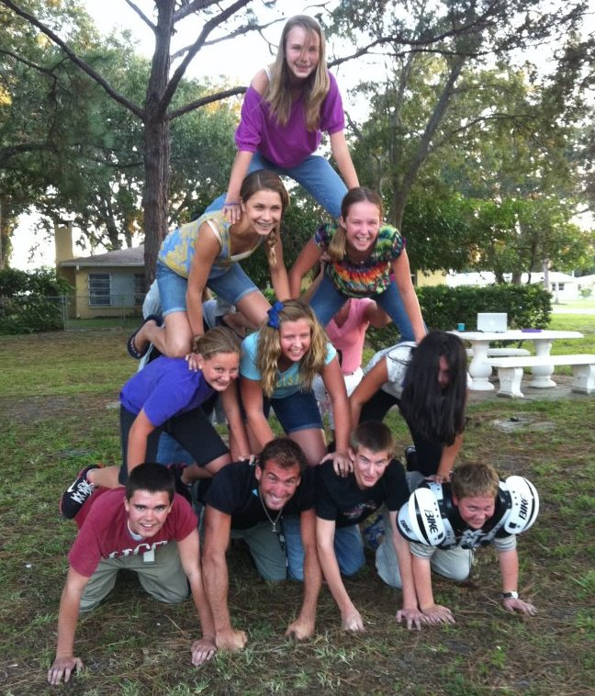
pyramid

Slide 15
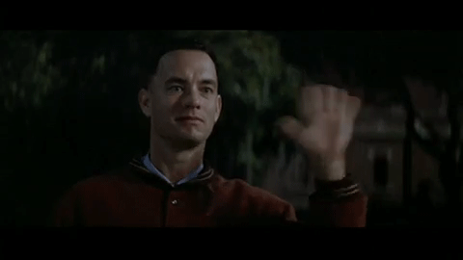
wave

Slide 16
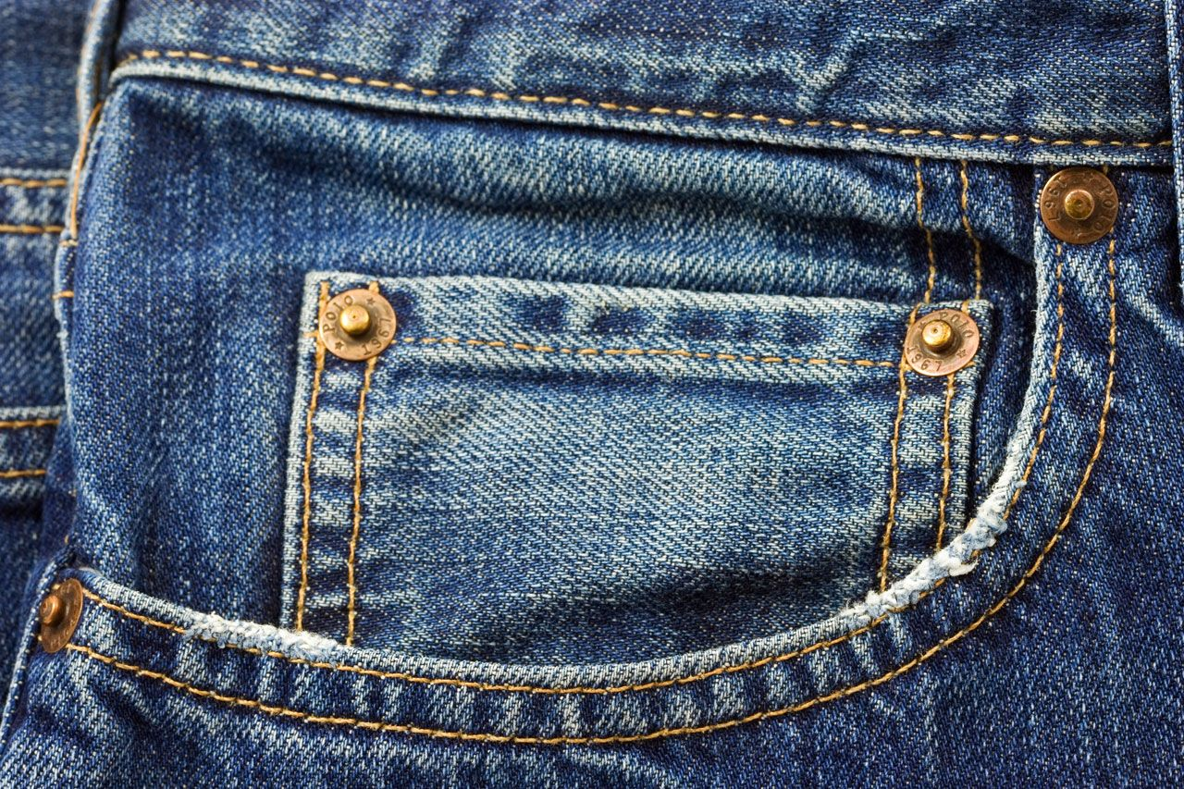
pocket

Slide 17
board

