Slide 1
New Girl in School

Slide 2
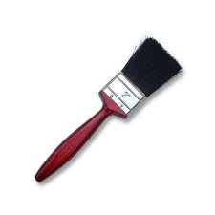
brush

Slide 3
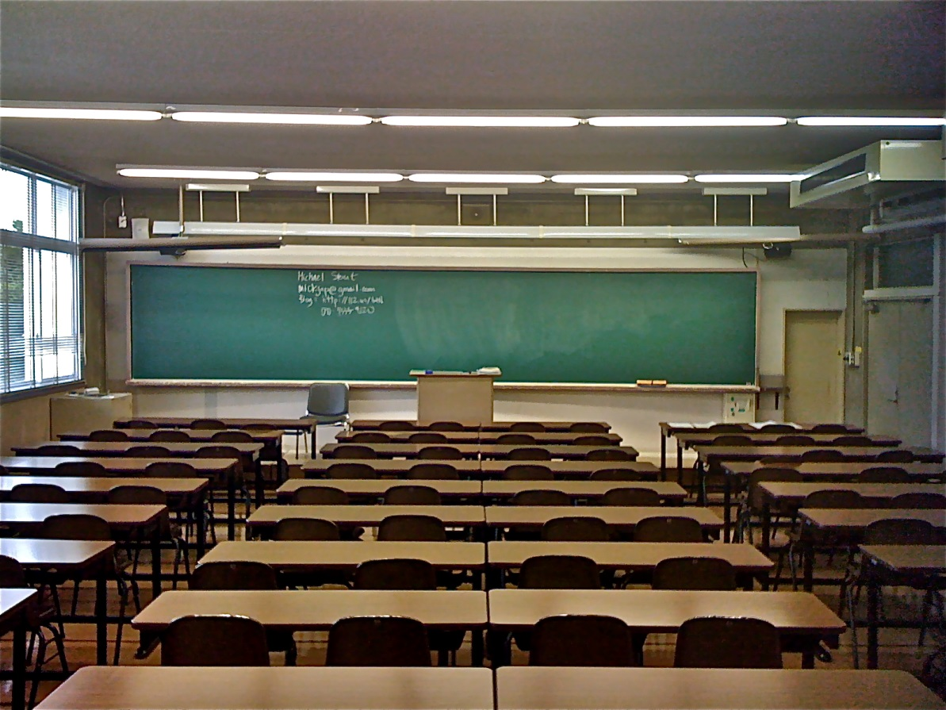
classroom

Slide 4
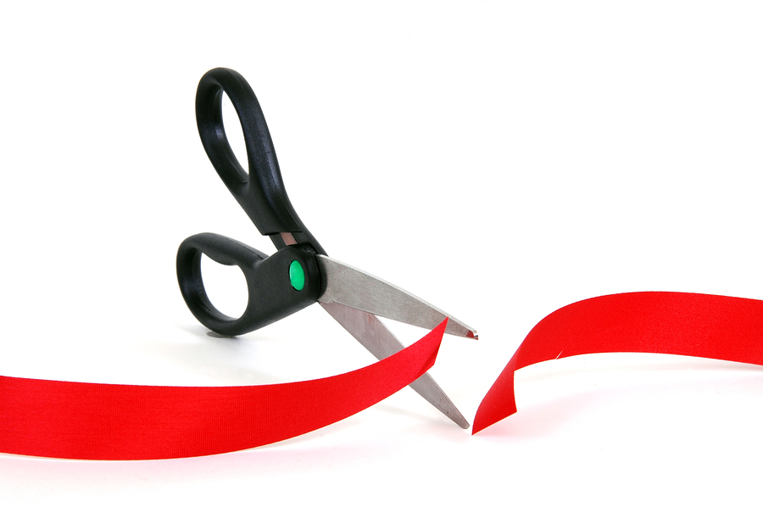
cut

Slide 5
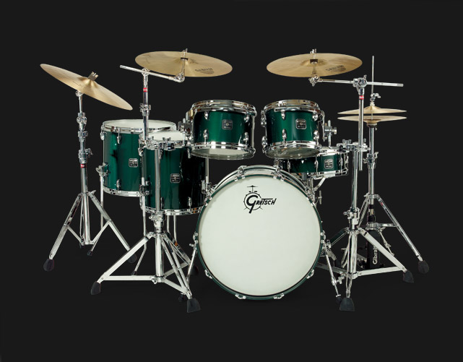
drums

Slide 6
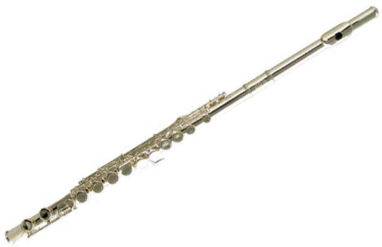
flute

Slide 7
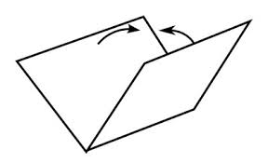
fold

Slide 8
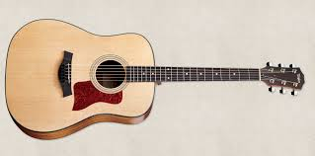
guitar

Slide 9
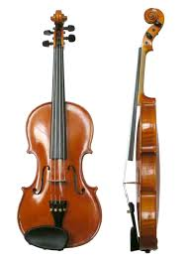
violin

Slide 10
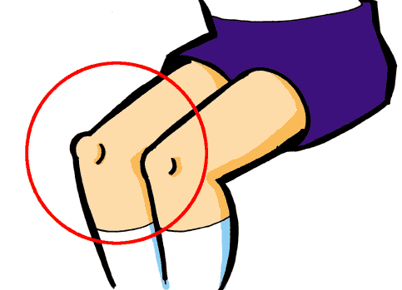
knee

Slide 11
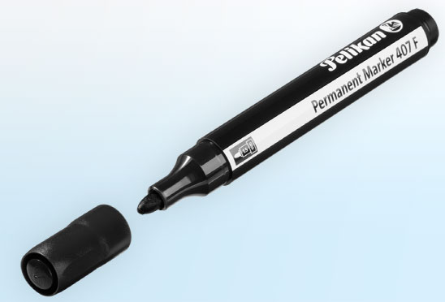
marker

Slide 12
paste

Slide 13
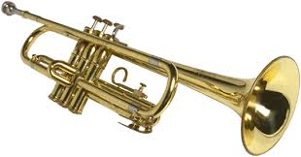
trumpet

Slide 14
shoulder

Slide 15
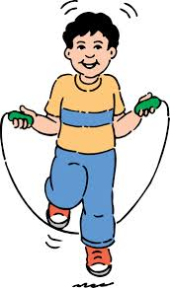
skip

Slide 16
sweep

Slide 17
switch off

Slide 18
brush

Slide 19
classroom

Slide 20
cut

Slide 21
drums

Slide 22
flute

Slide 23
fold

Slide 24
guitar

Slide 25
violin

Slide 26
knee

Slide 27
marker

Slide 28
paste

Slide 29
trumpet

Slide 30
shoulder

Slide 31
skip

Slide 32
sweep

Slide 33
switch off

