Slide 1
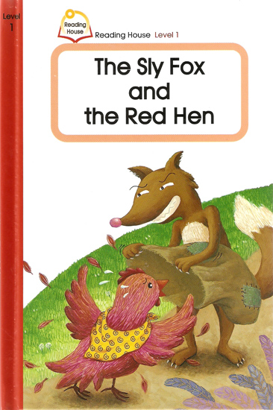
The Sly Fox and the Red Hen

Slide 2
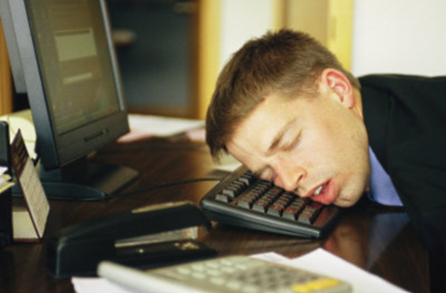
asleep

Slide 3
bag

Slide 4
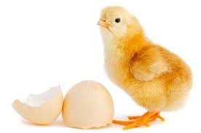
chick

Slide 5
cry

Slide 6
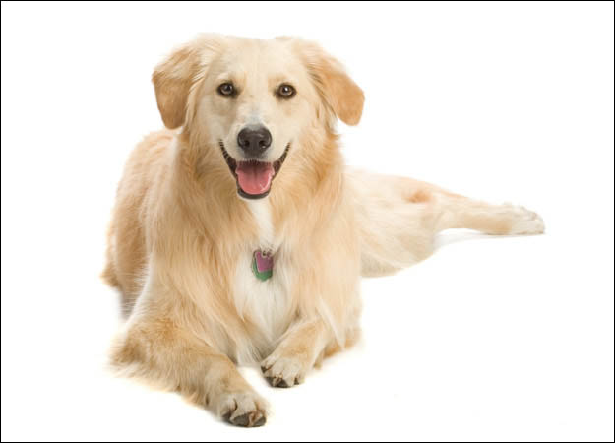
dog

Slide 7
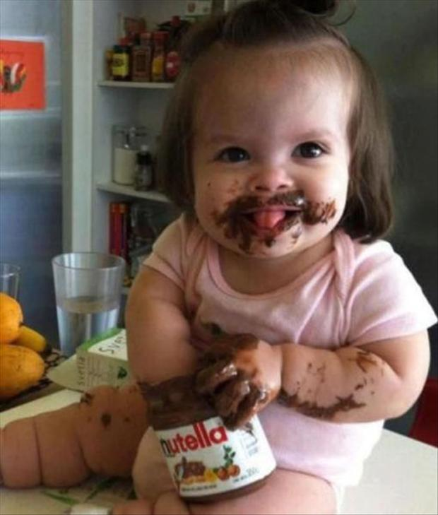
eat

Slide 8
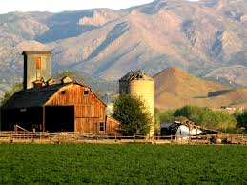
farm

Slide 9
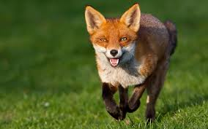
fox

Slide 10
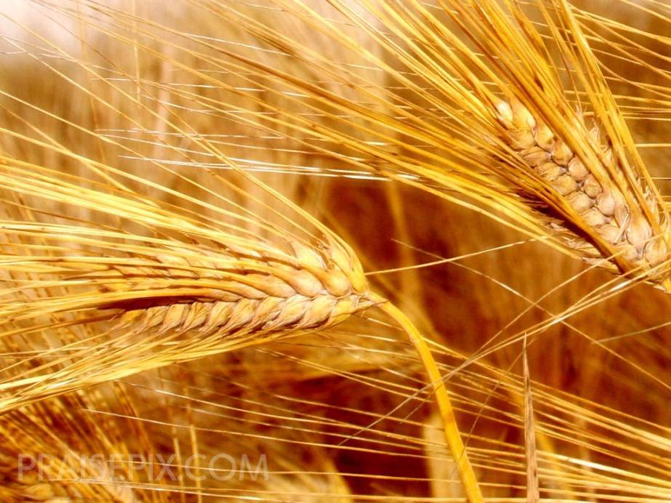
grain

Slide 11
happy

Slide 12
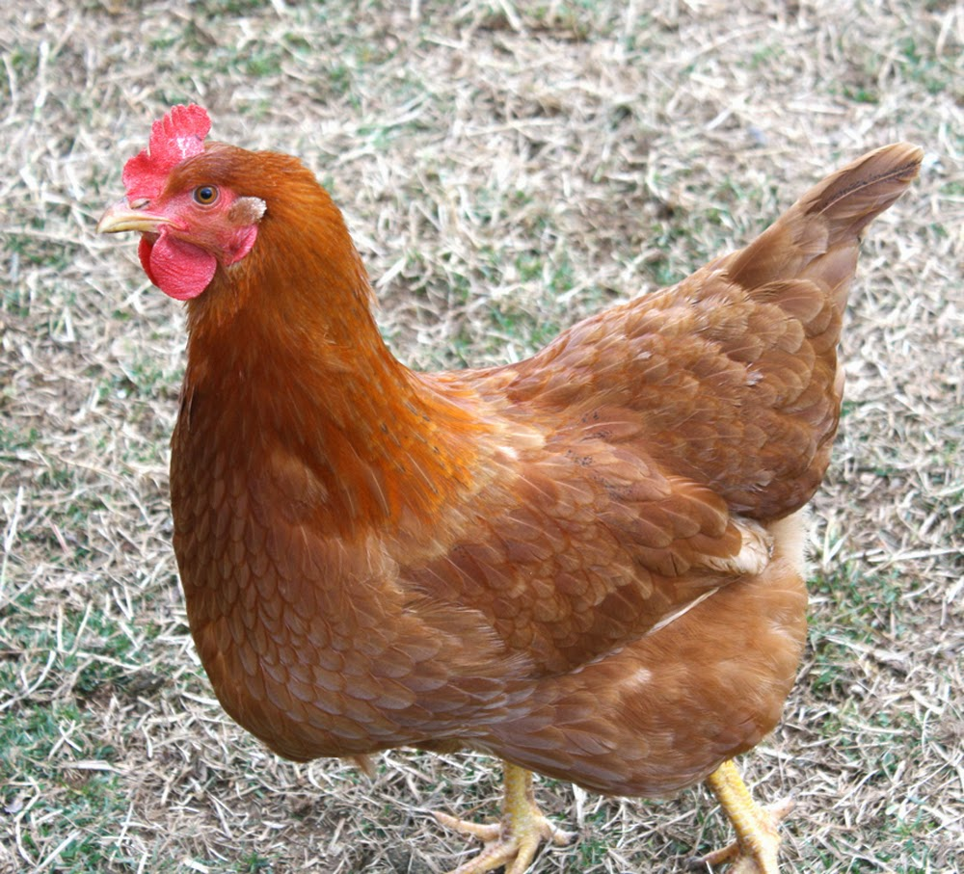
hen

Slide 13
house

Slide 14
red

Slide 15
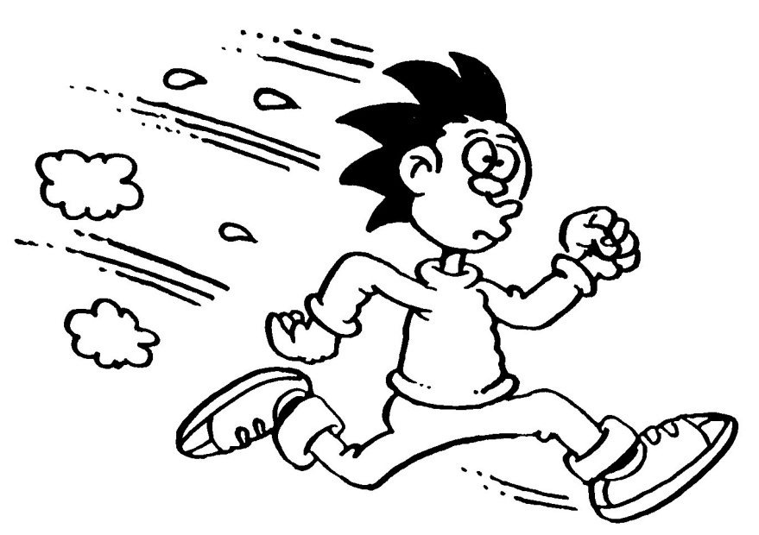
run

Slide 16
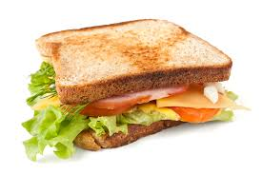
sandwich

Slide 17
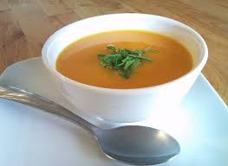
soup

Slide 18
Tic Tac Toe – Boys Vs. Girls
X | O
 | X | O
O | X | X

